Slide 1
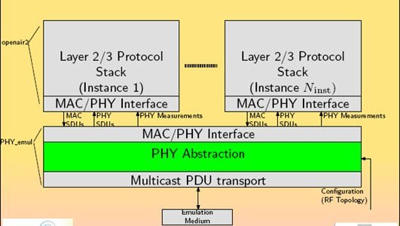
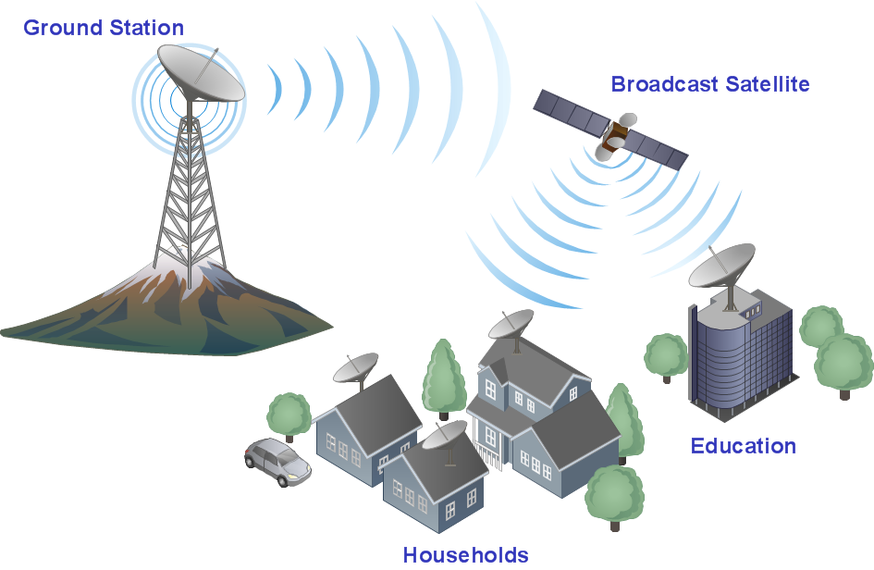
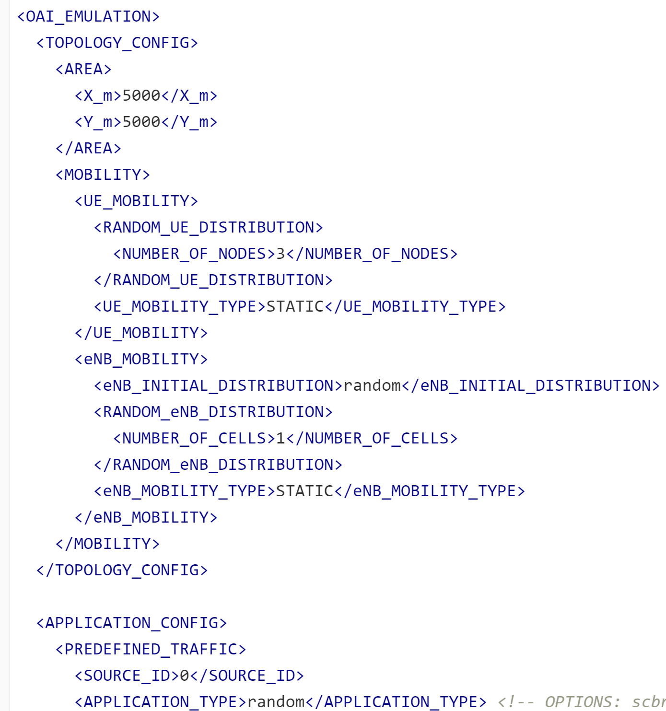
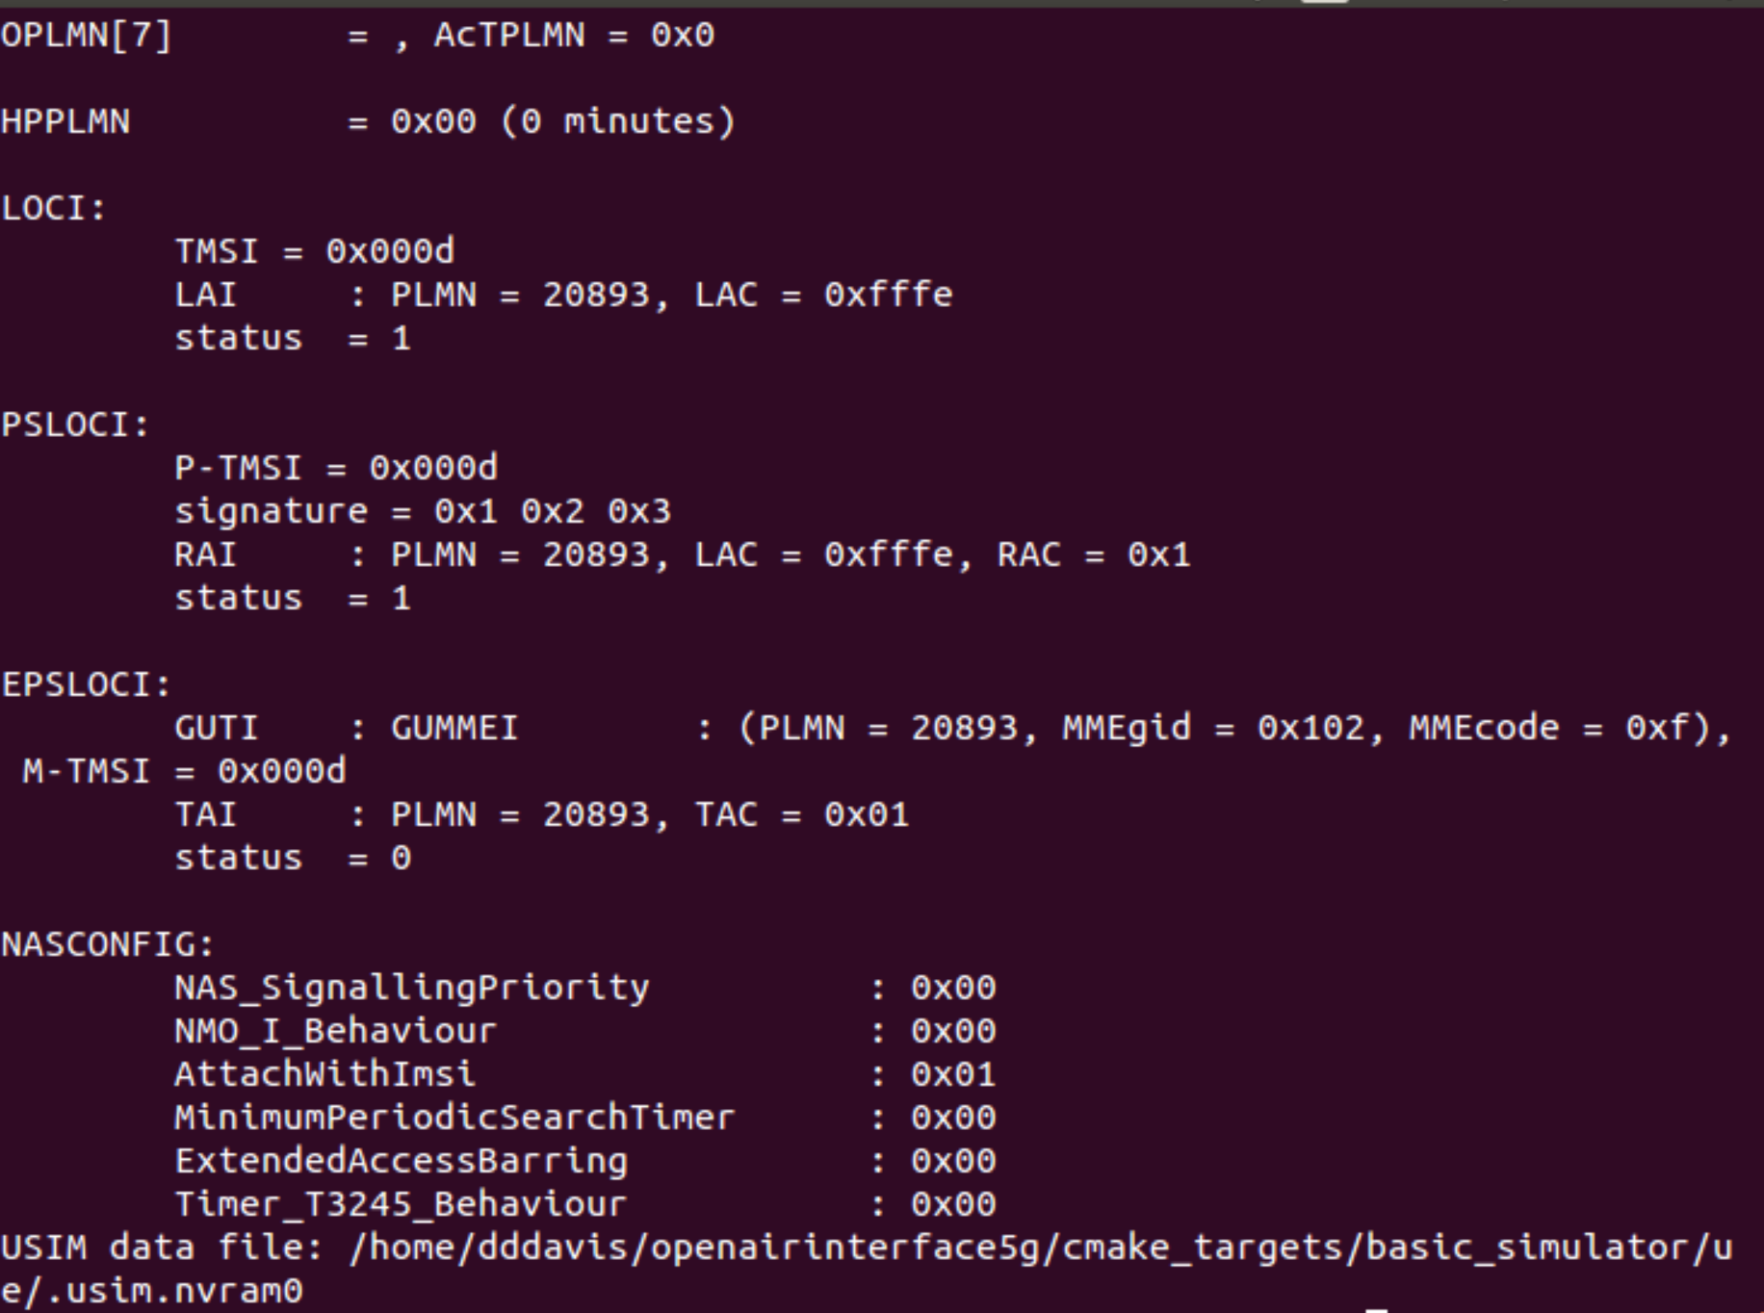
Group 35: Prototyping and Emulation Studies of Large Scale 5G Wireless Systems
Nolan Cardona, Dazhawn Davis, Ousmane Lloyd Ntutume, Andrew Whitehead, Rohan Willis
Faculty Advisors: Matthias Sander-Frigau, Hongwei Zhang
Introduction
Design Approach
Technical Details
The problem we were faced with in this project is improving a specific version of the codes (v.0.5.2) from the OpenAirInterface5g(OAI) platform, to be able to stimulate and emulate the current PHY abstraction layer.
Our solution is the interpretation of the code in more recent versions of the project and the emulation of 5G on the OpenAirINterface
Software Used:
OpenAirInterface
Ubuntu
Virtual Box
Git Bash
Obtaining understanding of the different layers of 5G networking
Interaction of 5G layers
Testing
Design Requirements
Focus on v0.5.2 and v1.1.0 of the project.
v0.5.2 was the last version that had a functioning physical abstraction mode
In order to implement this project a computer with a minimum of 500 GB of storage, i7 processor and at least 8 GB of RAM.
The computer can have either Windows OS or Mac OS as long as the Virtual Box & Ubuntu were imstalled.
No other software should be running alongside Ubuntu as simulations are done to ensure minimum outside interferance or undetected variables.
Analysis and testing took place in physical abstraction, simulation, and phymacinterface folders and files.
Set a size for the area the 5g will cover
Set the number of nodes
Set the number of cells
Run the emulation and study the results
Simulations ran in order to interpret differences in functionality and architecture.

